Slide 1
Sex linked Inheritance
Alleles on sex chromosomes are inherited in predictable patterns. For example, in Drosophila the locus for eye color is located on the X chromosome.
The allele for red eye color (RR), which is normal in wild flies, is dominant to the mutant allele for white eyes (rr).

Slide 2
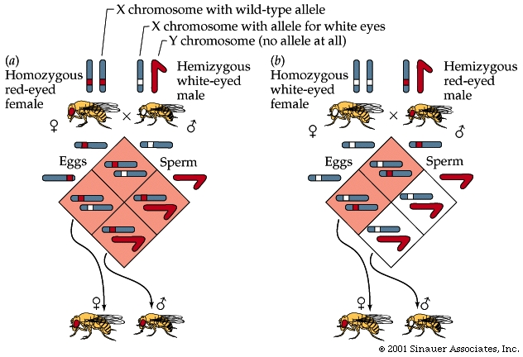
X linked Inheritance

Slide 3
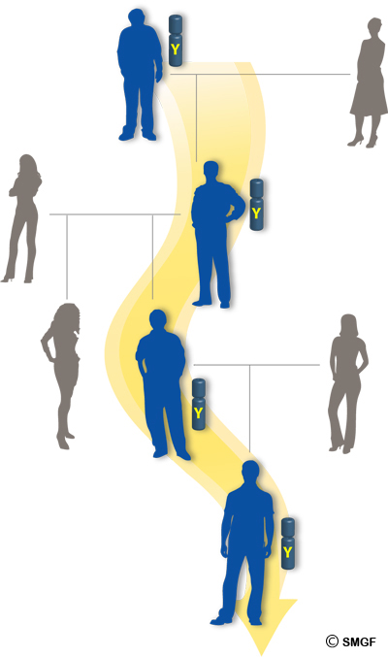
Y- linked inheritance
Y-linked inheritance: Inheritance of genes on the Y chromosome. Y-linked genes can only be transmitted from father to son.
Y-linked inheritance is also called holandric inheritance.
Ex. SRY (sex-determining region) for maleness.

Slide 4

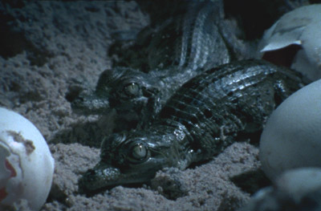
Temperature dependent sex determination
Alligators, crocodiles and turtles
Alligators & crocodiles: Incubation of eggs at 30ºC will results in female and temperature around 33ºC will results in males

Slide 5
ZW sex-determination system
Some birds, insects , reptiles etc
Males are the homogametic sex (ZZ), while females are the heterogametic sex (ZW).

Slide 6
Sex determination on Drosophila
The female determining genes are present on the X chromosome
But the male determining genes are present on the autosomes (2 sets autosomes)
Ratio of the number of X chromosomes and total set of autosomes determines the sex [ratio ≤ 0.5 results in males, ratio ≥1 results in females)
Genetic balance theory of sex determination

Slide 7
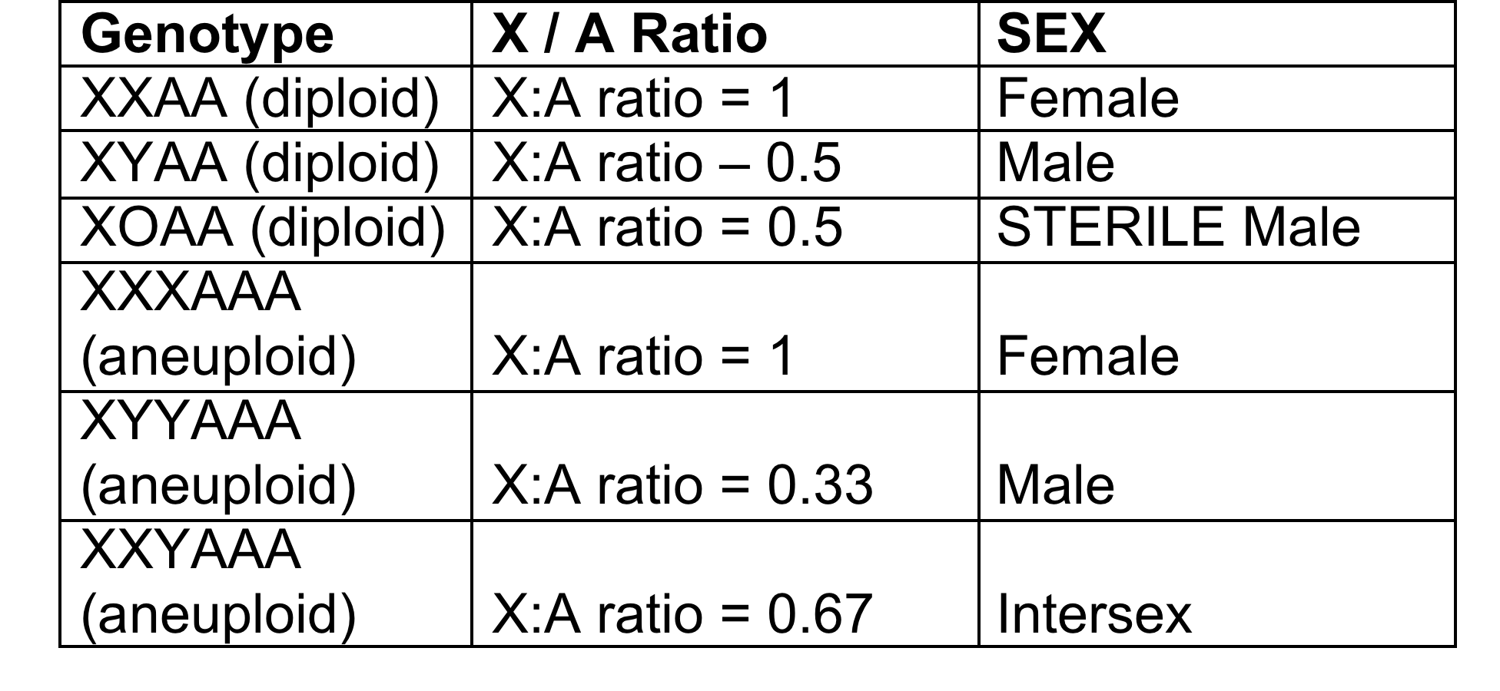
Sex Determination

Slide 8
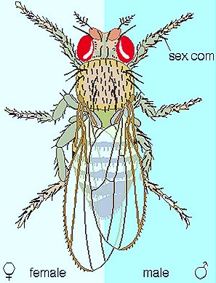
Gynandromorphs
An organism exhibiting both male and female characteristics
Abnormal behavior of the chromosome in insects

Slide 9
Pleiotropy
A gene that affects more than one trait.
Example:
In the human disease PKU (phenylketonuria). causes mental retardation and reduced hair and skin pigmentation

Slide 10
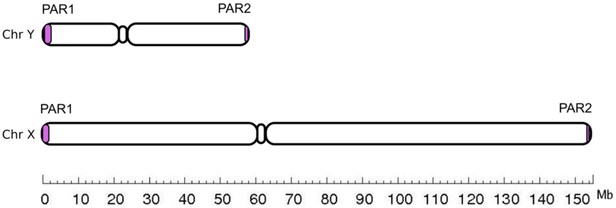
Similarity between X & Y chromosome
PseudoAutosomal Regions (PAR1, PAR2) are homologous sequences of nucleotides on the X and Y chromosome

Slide 11
Genetic terms commonly used to describe the type of alleles
Amorphic allele: A mutation that causes complete loss of gene function. Amorph is sometimes used interchangeably with "genetic null".
Hypomorph allele : A mutation that causes a partial loss of gene function
Hypermorph allele: A mutation that causes an increase in normal gene function. Hypermorphic alleles are dominant gain of function alleles.
Antimorph allele: A dominant mutation that acts in opposition to normal gene activity. Antimorphs are also called dominant negative mutations
Neomorphic allele: A mutation that causes dominant gain of gene function that is different from the normal function

Slide 12
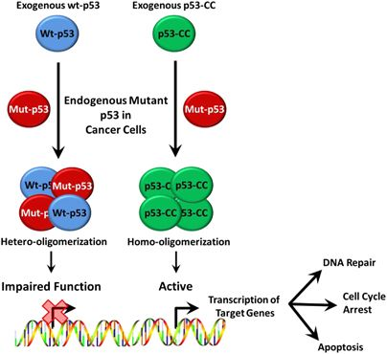
Dominant negative mutation
WT-p53

Slide 13
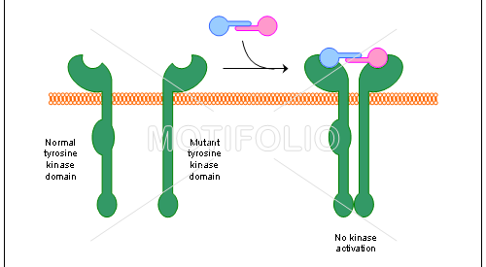
Dominant negative (Example)

